Slide 1
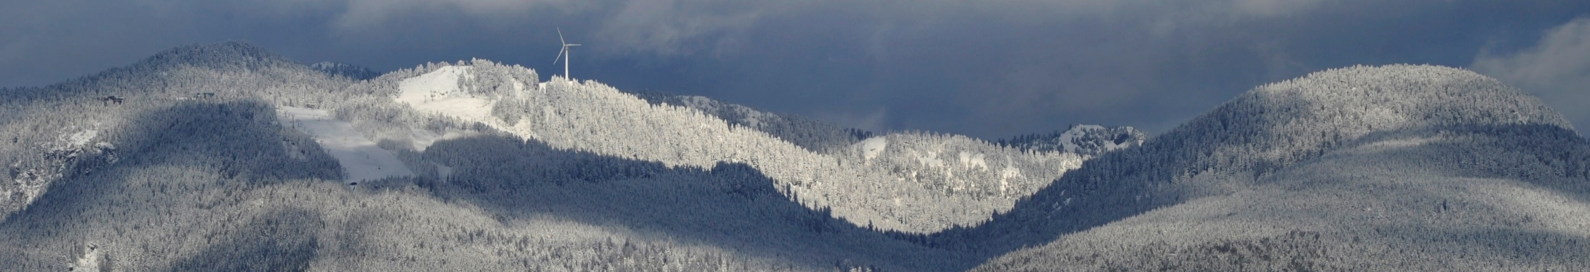
Functional connectivity and multimodal analyses of MEG and fMRI data during hypothesis judgment
Jennifer C. Whitman, PhD
University of British Columbia
Department of Psychology

Slide 2
Cognitive Psychology
Whitman, J.C., & Woodward, T. S. (2012). Organizational Behavior and Human Decision Processes
Whitman, J.C., & Woodward, T.S. (2011). Psychonomic Bulletin & Review
Whitman,, J.C., Zhao, J & Todd, R. (under review). Psychonomic Bulletin & Review
fMRI
Lavigne, K. M., Rapin, L. A., Metzak, P. D., Whitman, J. C., Jung, K., Dohen, M., Lœvenbruck, H., & Woodward, T. S. (2015). Schizophrenia Bulletin.
Whitman, J.C., Metzak, P.D., Lavigne, K., & Woodward, T. S. (2013). Neuropsychologia
Rapin, L., Lovevenbruck, H., Dohen, M., Metzak, P. D., Whitman, J. C., & Woodward, T. S. (2012). Psychiatry Research: Neuroimaging
Metzak, P.D., Riley, J., Wang, L., Whitman, J.C., Ngan, E.T.C. & Woodward, T.S. (2011). Schizophrenia Bulletin.
Cognitive Neuropsychiatry of Schizophrenia
Whitman, J.C., Menon, M., Kuo, S., & Woodward, T. S. (2012). Cognitive Neuropsychiatry
Speechley, W.J., Whitman, J.C., & Woodward, T.S. (2010). Journal of Psychiatry and Neuroscience
Woodward, T. S., Menon, M., & Whitman, J. C. (2007). Cognitive Neuropsychiatry
Woodward, T. S., Moritz, S., Arnold, M. M., Cuttler, C., Whitman, J. C., & Lindsay, S. (2006). Neuropsychology
Woodward, T. S., Moritz, S., Cuttler, C., & Whitman, J. C. (2006). Journal of Clinical and Experimental Neuropsychology
Woodward, T. S., Whitman, J. C., Arbuthnott, K., Kragelj, T., Lyons, J., & Stip, E. (2005). Cognitive Neuropsychiatry
Moritz, S., Woodward, T. S., Whitman, J. C., & Cuttler, C. (2005). Journal of Nervous and Mental Disease
Moritz, S., Woodward, T. S., Cuttler, C., Whitman, J. C., & Watson, J. M. (2004). Neuropsychogy
ERP, EEG, MEG
Whitman, J.C., Takane, Y., Cheung, T.C., Moiseev, A., Ribary, U., Ward, L, & Woodward, T.S. (2016). NeuroImage.
McDonald, J. J., Whitman, J. C., Störmer, V. S., & Hillyard, S. A. (2014). Involuntary cross-modal spatial attention influences visual perception. in Cognitive Electrophysiology of Attention: Signals of the Mind, Ed. Ron Mangun
Grundy, J. G., Benarroch, M. F. F., Woodward, T. S., Metzak, P. D. & Whitman, J.C. & Shedden, J. M. (2013). Human Brain Mapping
Whitman, J.C., Ward, L. M., & Woodward, T. S. (2013). Frontiers in Human Neuroscience.
McDonald, J. J., Hickey, C., Green, J. J., & Whitman, J. C. (2009). Journal of Cognitive Neuroscience
Van Snellenberg, J. X., Whitman, J., McDonald, J. J., & Liotti, M. (2007). International Congress Series
Constrained PCA, genetics & multi-unit recordings
Ehlers, M. R., Whitman, J. C., Anderson, A. K., Müller, D. J., Freeman, N., Palombo, D. J., Levine, B., & Todd, R. M (under review). PeerJ.
Hyman, J. M., Whitman, J. C., Emberly, E., Woodward, T. S. & Seamans, J. K. (2013). Cerebral Cortex
Notes:
I was drawn to my PhD lab by the opportunity to learn about functional connectivity analysis and fMRI
- That lab also focused on schizophrenia research

Slide 3
Background
Delusional Schizophrenia Patients:
are biased against evidence disconfirming their current interpretation
jump to conclusions without gathering sufficient evidence

Slide 4
Background
In probabilistic reasoning tasks, delusional schizophrenia patients overestimate the probability of the hypothesis best supported by the evidence, relative to:
non-delusional schizophrenia patients
healthy controls
mathematical norm
hypersalience of evidence-hypothesis matches

Slide 5
Research Question
What underlies judgments of evidence-hypothesis matches, in healthy individuals?
cognitive coherence: the evidence & hypothesis should form a more stable, salient mental representation (gestalt)
What neural mechanisms are involved?

Slide 6
Cognitive Paradigm
To investigate the brain systems involved in hypothesis judgment, we used a cognitive task with objectively quantifiable evidence strength and two competing hypotheses.

Slide 7
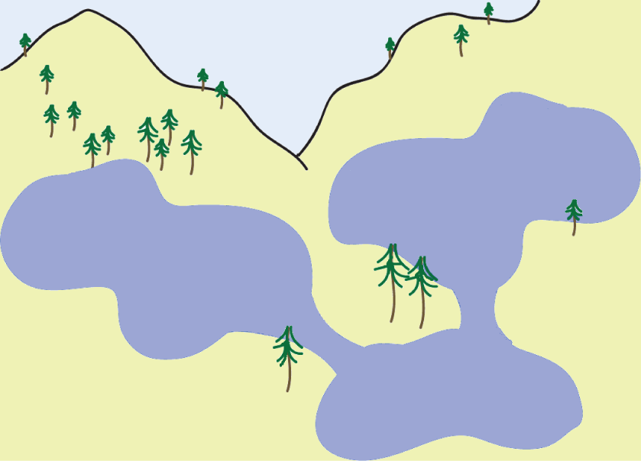
Notes:
Which lake is the jumping white fish most likely to have migrated from?

Slide 8
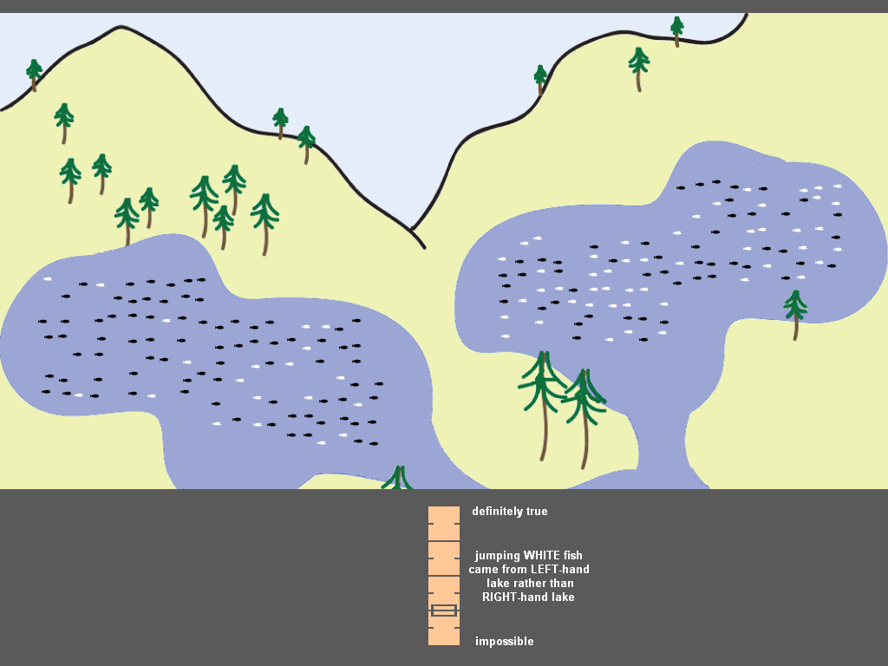
definitely true
jumping WHITE fish from LEFT-hand lake rather than RIGHT-hand lake
impossible
Notes:
I would ask you ‘how likely is it that the white fish you just saw jumping in the downstream lake came from the left-hand upstream lake rather than the right-hand upstream lake?’
The cursor starts at the midpoint of the likert scale, and you move it up if you agree with the focal hypothesis, and down if you disagree.

Slide 9
alternative hypothesis
focal hypothesis
definitely true
jumping WHITE fish from LEFT-hand lake rather than RIGHT-hand lake
impossible
Notes:
Easy to tell whether to go above or below the midline on the likert scale.
So, the condition where the evidence supports the focal hypothesis and the condition where the participant chooses to accept the focal hypothesis are practically the same.
Similarly, the condition where the evidence supports the alternative hypothesis and the condition where the participant chooses to reject the focal hypothesis are practically the same.

Slide 10
Key Terminology
Focal Hypothesis: the hypothesis (the lake) we ask the participant about – the one we draw attention to
Accept Focal Condition: the evidence supports accepting the focal hypothesis – AKA evidence-hypothesis matches
Reject Focal Condition: the evidence supports rejecting the focal hypothesis, in favour of the alternative hypothesis

Slide 11
fMRI-CPCA
Identifies functionally connected brain networks, like PCA, ICA, & correlations with a seed region
but… all of the networks identified by fMRI-CPCA represent changes in activity predictable from task timing.

Slide 12
Expected Results
What functionally connected brain systems would we expect to see involved?
Yeo et al (2011). Jnl Neurophys

Slide 13
Expected Results
for evidence-supported hypotheses, stronger functional connectivity in the frontoparietal network (FPN) or dorsal attention network (DAN)
would be consistent with a more stable, salient mental representation (gestalt) corresponding to evidence-hypothesis matches

Slide 14
fMRI-CPCA
voxels
fMRI data
s1 run1
scans
s1 run2
s2 run1
.……….
s21 run2

Slide 15
fMRI-CPCA
voxels
voxels
voxels
fMRI data
fMRI data
predictable
from task timing
fMRI data
not predictable from task timing
(residuals)
s1 run1
scans
scans
scans
s1 run2
regression
(constrains
variance)
s2 run1
+
.……….
s21 run2
Notes:
In the regression, we use a finite impulse response (FIR) model, so that we make no assumptions about the shape of the hemodynamic response

Slide 16
fMRI-CPCA
loadings:
spatial pattern across voxels
loadings:
spatial pattern across voxels
voxels
component 1
component 2
fMRI data
predictable
from task timing
scans
component scores: time course across scans
component scores: time course across scans
PCA
component 1
component 2

Slide 17
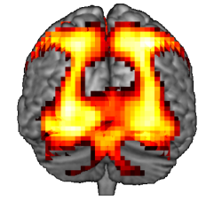
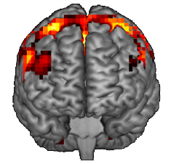
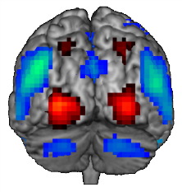
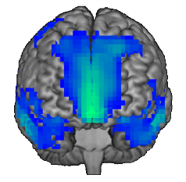
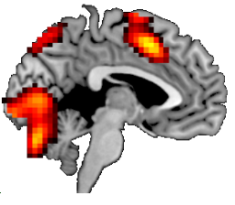
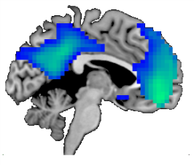
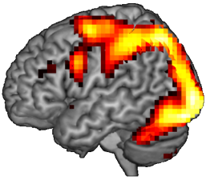
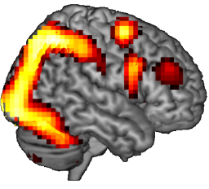
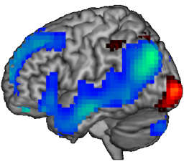
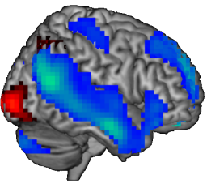
fMRI-CPCA: Principal Components 1 and 2
Component 1
Component 2
Whitman, Metzak, Lavigne & Woodward (2013). Neuropsychologia
Notes:
These are not maps of t-values – they’re component loadings (right singular vector) thresholded to best display cluster shapes
Frontoparietal network, dorsal attention network. (‘task-positive network’)
Tend to get strong parietal and lateral occipital activity in tasks with large visual displays
Default mode network (‘task negative network’)

Slide 18
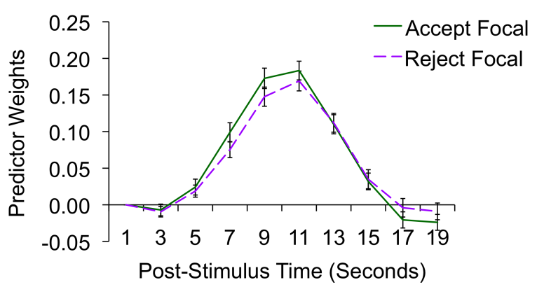
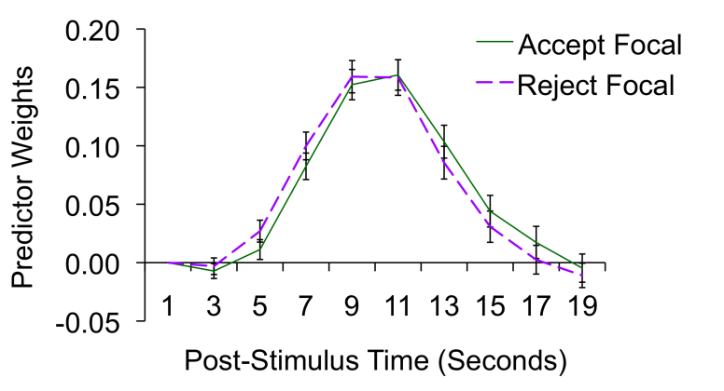
fMRI-CPCA: Principal Components 1 and 2
Component 1
Component 2
Whitman, Metzak, Lavigne & Woodward (2013). Neuropsychologia
Notes:
Time course graphs show predictor weights, produced by regressing component scores onto the matrix of predictors created from the timing vectors for each condition and each participant.
The higher the predictor weight, the more strongly the spatial pattern shows up – so, a high predictor weight in the graph on the right means strong deactivation in DMN regions

Slide 19
Could we identify more than one network involved in this task, in order to
better discriminate between
component cognitive functions?

Slide 20
MEG-PCA functional connectivity analysis
source localization via beamformer algorithm to produce whole-brain images
high temporal resolution: 50 ms windows via sliding average
different frequencies of cortical oscillations

Slide 21
MEG-PCA
voxels
voxels
voxels
0 ms post-stimulus
3-7 Hz
(theta)
7-13Hz
(alpha)
18-24 Hz
(beta)
50 ms post-stimulus
s1 condition 1
100 ms post-stimulus
.……….
s21 condition 4
Whitman, Takane, Cheung, Moiseev, Ribary, Ward & Woodward (2016). NeuroImage
Notes:
Same participants as fMRI study
Sliding average for overlapping time windows

Slide 22
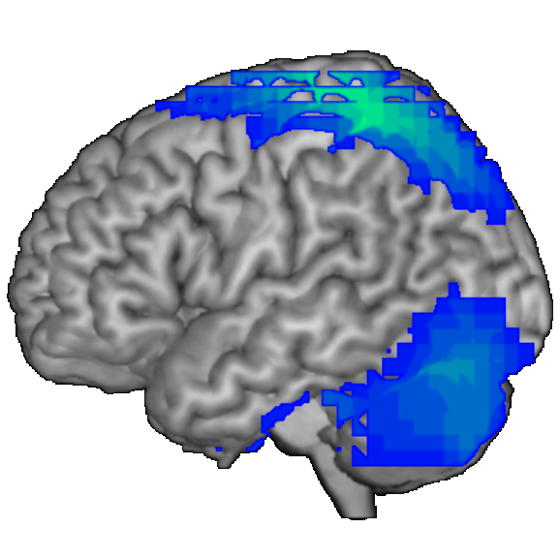
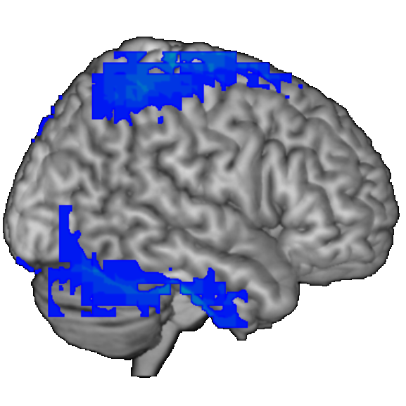
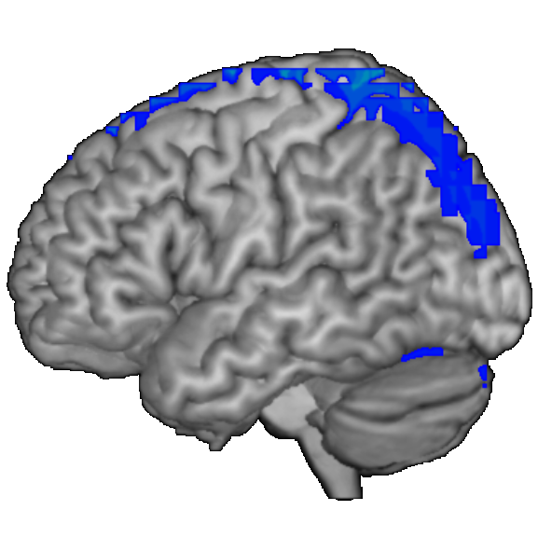
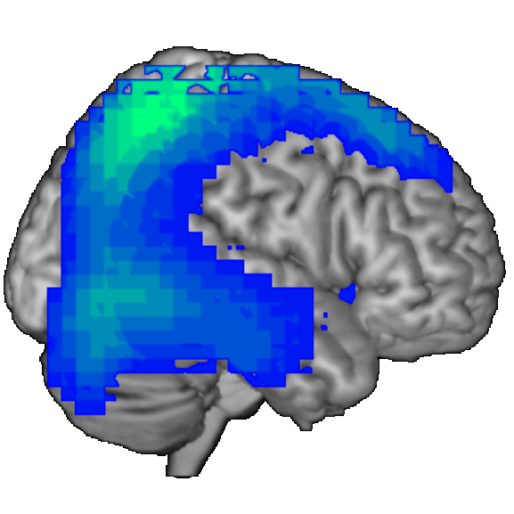
MEG-PCA: Principal Component 1
alpha (~10 Hz) power
Component Scores
beta (~21 Hz) power
Whitman, Takane, Cheung, Moiseev, Ribary, Ward & Woodward (2016). NeuroImage

Slide 23
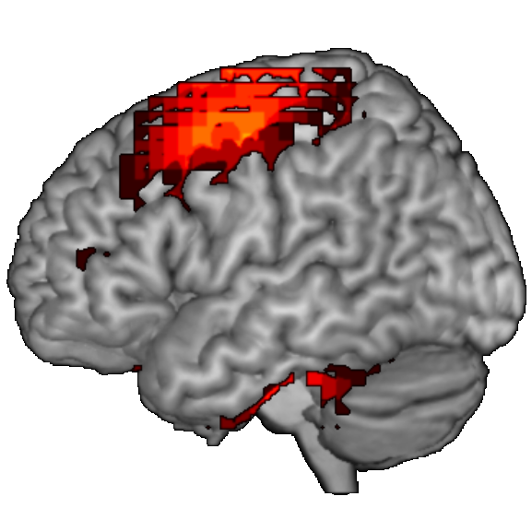
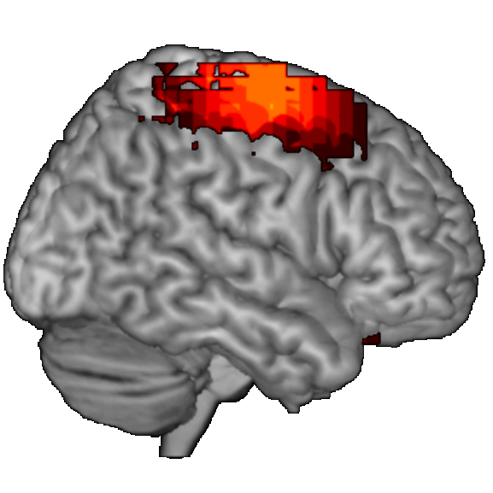
MEG-PCA: Principal Component 2
theta (~5 Hz) power
Component Scores
Whitman, Takane, Cheung, Moiseev, Ribary, Ward & Woodward (2016). NeuroImage

Slide 24
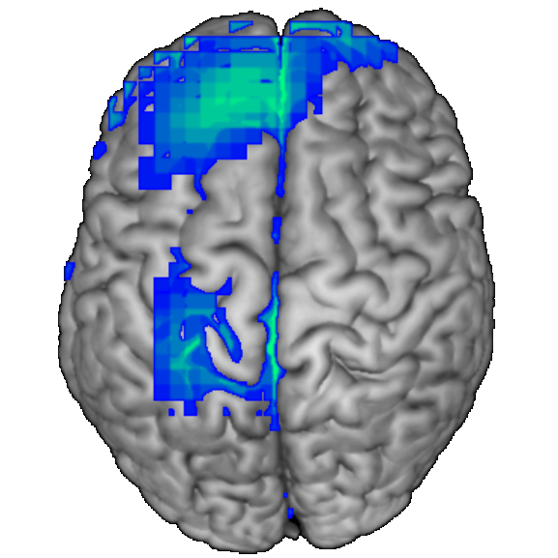
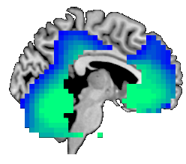
MEG-PCA: Principal Component 3
beta (~21 Hz) power
Component Scores
Whitman, Takane, Cheung, Moiseev, Ribary, Ward & Woodward (2016). NeuroImage

Slide 25
Multimodal MEG-fMRI-CPCA
In the previous CPCA analysis of fMRI data, we constrained the variance to what was predictable from task timing via row-wise regression.
voxels
50 ms time bins
MEG data
In our CPCA analysis merging MEG and fMRI data, we constrained the variance in the MEG data to what was predictable from the spatial patterns of the fMRI networks via column-wise regression.
Whitman, Takane, Cheung, Moiseev, Ribary, Ward & Woodward (2016). NeuroImage

Slide 26
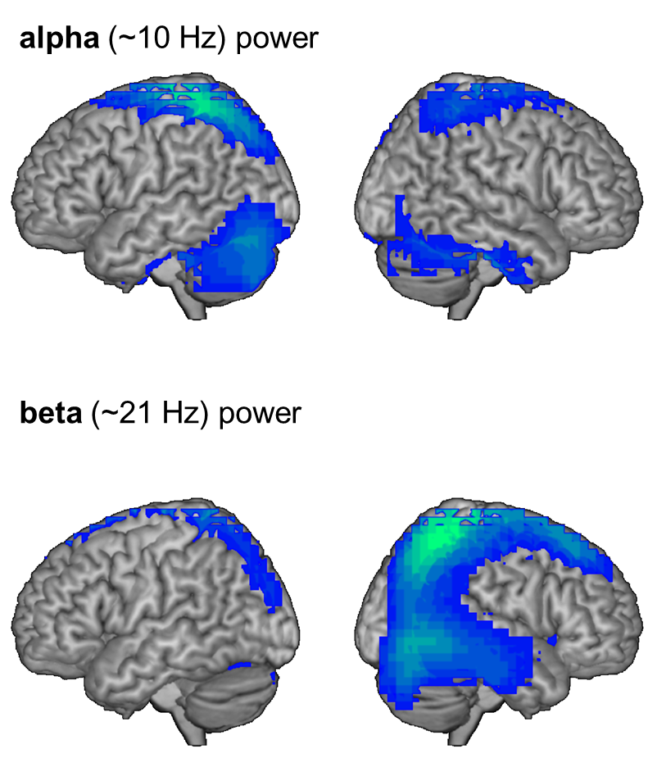
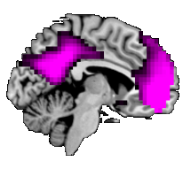
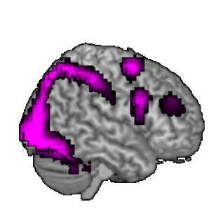
MEG-fMRI-CPCA: Principal Component 1
Multimodal MEG-fMRI Analysis
Unimodal MEG Analysis
frontal and parietal decreases in alpha and
beta power
Whitman, Takane, Cheung, Moiseev, Ribary, Ward & Woodward (2016). NeuroImage
Notes:
The first network found in the unimodal MEG analysis and the first network found in the multimodal meg-fmri analysis seem to have similar spatial patterns of activity, involving decreases in alpha and beta frequency power in parietal and frontal regions.

Slide 27
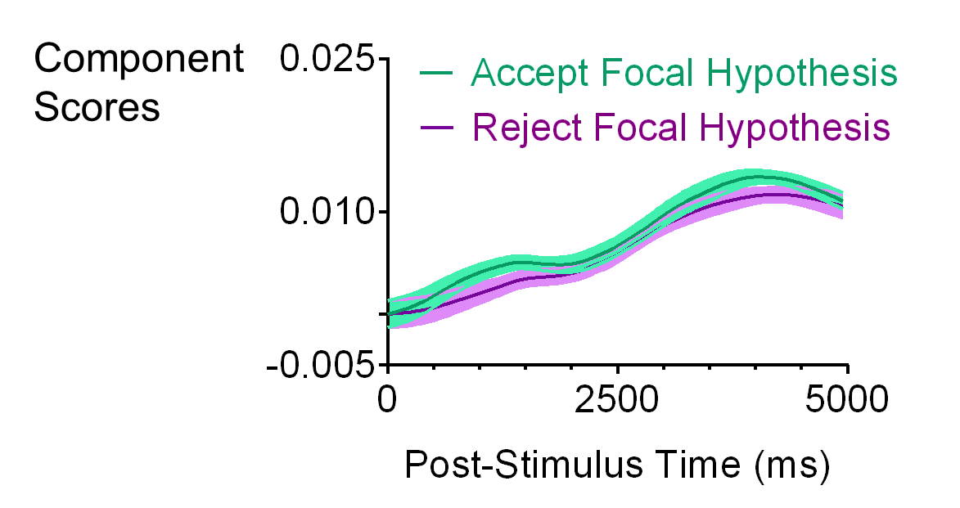
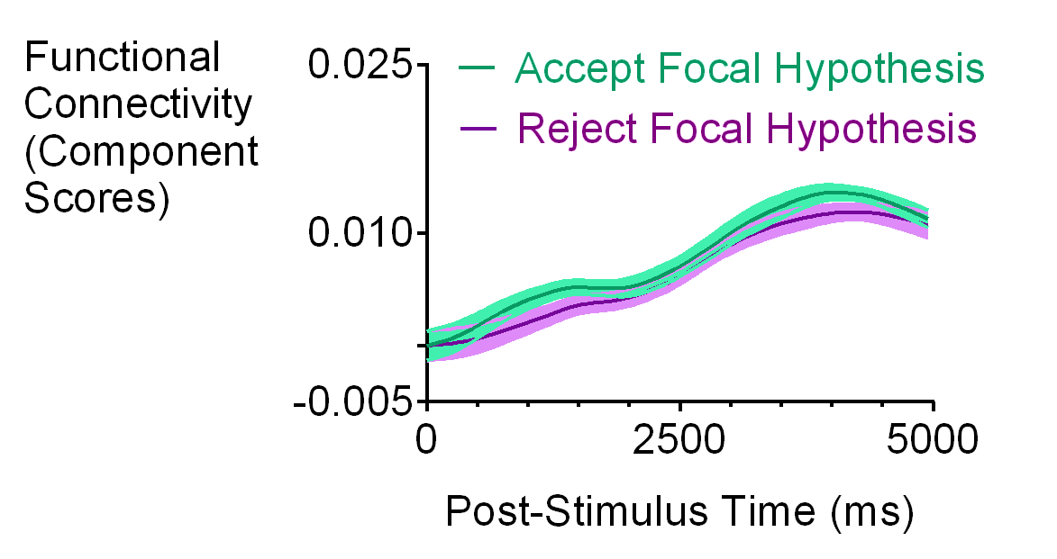
MEG-fMRI-CPCA: Principal Component 1
Multimodal MEG-fMRI Analysis
Unimodal MEG Analysis
Component Scores
Whitman, Takane, Cheung, Moiseev, Ribary, Ward & Woodward (2016). NeuroImage
Notes:
The first network found in the unimodal MEG analysis and the first network found in the multimodal meg-fmri analysis also seem to have extremely similar timecourses of activity. While slight difference become visible upon very close inspection, these timecourses are so similar that we can say this is the same network. So, this finding is replicated between the unimodal and multimodal analyses. This close match adds credence to the source localization done on the MEG data by the beamformer algorithm.

Slide 28
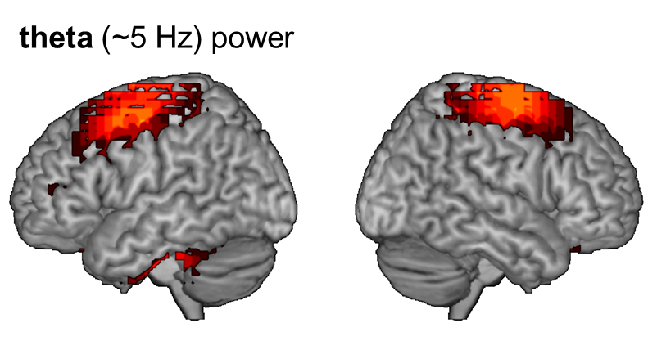
MEG-fMRI-CPCA: Principal Component 2
Multimodal MEG-fMRI Analysis
Unimodal MEG Analysis
parietal increases in theta power
Whitman, Takane, Cheung, Moiseev, Ribary, Ward & Woodward (2016). NeuroImage

Slide 29
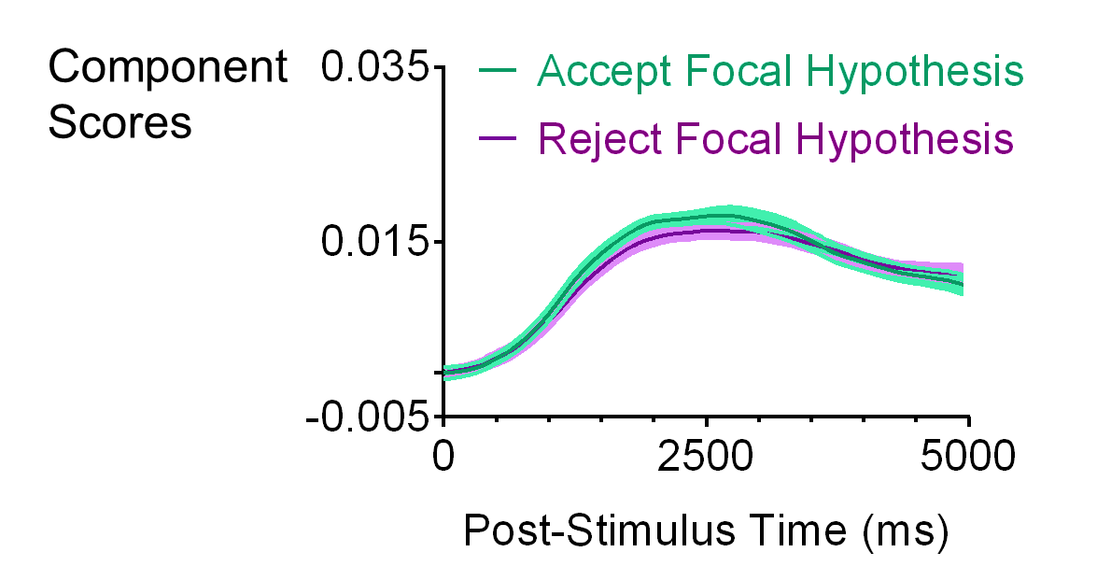
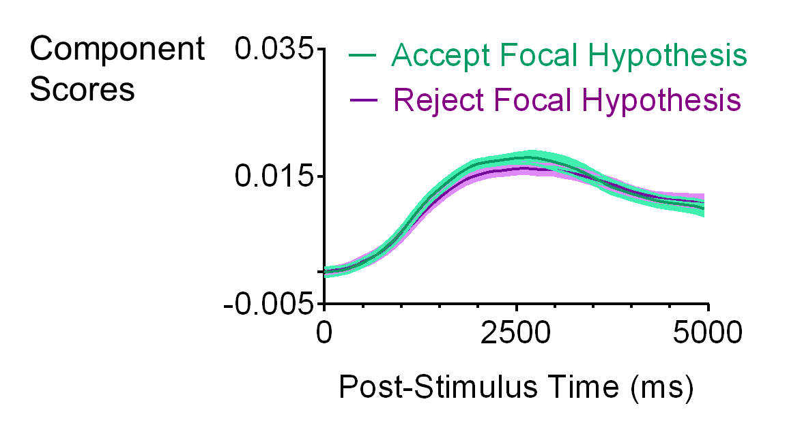
MEG-fMRI-CPCA: Principal Component 2
Multimodal MEG-fMRI Analysis
Unimodal MEG Analysis
Component Scores
Whitman, Takane, Cheung, Moiseev, Ribary, Ward & Woodward (2016). NeuroImage

Slide 30
MEG-fMRI-CPCA: Principal Component 3
Multimodal MEG-fMRI Analysis
Unimodal MEG Analysis
frontal and parietal decreases in beta power
beta (~21 Hz) power
Whitman, Takane, Cheung, Moiseev, Ribary, Ward & Woodward (2016). NeuroImage

Slide 31
MEG-fMRI-CPCA: Principal Component 3
Multimodal MEG-fMRI Analysis
Unimodal MEG Analysis
Component Scores
Whitman, Takane, Cheung, Moiseev, Ribary, Ward & Woodward (2016). NeuroImage

Slide 32
Summary of Findings
Multimodal Analysis
When we constrain the MEG networks to those predictable from the spatial patterns of the fMRI networks, we get the same three principal components.
confirms source localization performed by beamformer algorithm

Slide 33
Summary of Findings
In both fMRI and MEG, we see involvement of the:
Somatomotor Network
Visual Network
Dorsal Attention Network (DAN)
Frontoparietal Network (FPN)
fMRI
stronger network signal in the visual network, DAN & FPN when evidence supports accepting focal hypothesis
MEG
stronger signal from the left DLPFC and midline regions late in the trial from a network dominated by beta frequency (~21 Hz) oscillations.

Slide 34
General Discussion & Implications
Cognitive Neuroscience Methods
For identifying distinct networks which may underlie distinct cognitive functions, distinguishing between different frequencies of oscillations may be as important as gaining high spatial and temporal resolution - perhaps even more important.
Hypothesis Judgment & Evidence Integration
Could stronger activity in functionally connected networks in response to evidence-hypothesis matches also underlie other biases in hypothesis judgment, such as confirmation bias?
Delusions in Schizophrenia
Would we expect stronger signals from these networks in delusional schizophrenia patients, who find evidence-hypothesis matches hypersalient?

Slide 35





Acknowledgments
Postdoctoral Supervisor: Rebecca Todd
Doctoral Supervisor: Todd Woodward
Current Collaborators & Supervisory & Comp Exam Committee Members: Jason Barton, Todd Handy, Elton Ngan, Lawrence Ward, Jeremy Seamans, Jiaying Zhao
Research Assistants: Cassandra Bethel, Patrick Carolan, Tzuhan Cheng, Hoiki Cheung, Jessica Ferguson-King, Alissa Low, Bevan Lugg, John Paiement, Paniz Pasha, Rochelle Picardo, Emilie Ptak, Nuwan Rajapakse, Jennifer Riley, Kevin Roberts, Hannah Sangra, Emily Stewart, HwaBaek Song, Nicole Tsang, Joyce Tse, Michelle Zhang.
Graduate Students, Post-Docs & Research Associates Involved in CPCA Development: Mana Ehlers, Eva Feredoes, Kwanghee Jung, Katie Lavigne, Paul Metzak, Nicole Sanford, Will Speechley, Christine Tipper, Liang Wang
MRI & Facilities: UBC 3T MRI Research Centre, Down Syndrome Research Foundation MEG Facility
Funding: CIHR, NSERC, MSFHR
High-Performance Computing Facilities:
WestGrid, part of Compute Canada

Slide 36
Cognitive Psychology
Whitman, J.C., & Woodward, T. S. (2012). Organizational Behavior and Human Decision Processes
Whitman, J.C., & Woodward, T.S. (2011). Psychonomic Bulletin & Review
Whitman,, J.C., Zhao, J & Todd, R. (under review). Psychonomic Bulletin & Review
fMRI
Lavigne, K. M., Rapin, L. A., Metzak, P. D., Whitman, J. C., Jung, K., Dohen, M., Lœvenbruck, H., & Woodward, T. S. (2015). Schizophrenia Bulletin.
Whitman, J.C., Metzak, P.D., Lavigne, K., & Woodward, T. S. (2013). Neuropsychologia
Rapin, L., Lovevenbruck, H., Dohen, M., Metzak, P. D., Whitman, J. C., & Woodward, T. S. (2012). Psychiatry Research: Neuroimaging
Metzak, P.D., Riley, J., Wang, L., Whitman, J.C., Ngan, E.T.C. & Woodward, T.S. (2011). Schizophrenia Bulletin.
Current & Future Directions
How does the brain organize information in short-term memory?
What roles do different frequencies of oscillations play in memory?
What about coupling between frequencies?
Cognitive Neuropsychiatry of Schizophrenia
Whitman, J.C., Menon, M., Kuo, S., & Woodward, T. S. (2012). Cognitive Neuropsychiatry
Speechley, W.J., Whitman, J.C., & Woodward, T.S. (2010). Journal of Psychiatry and Neuroscience
Woodward, T. S., Menon, M., & Whitman, J. C. (2007). Cognitive Neuropsychiatry
Woodward, T. S., Moritz, S., Arnold, M. M., Cuttler, C., Whitman, J. C., & Lindsay, S. (2006). Neuropsychology
Woodward, T. S., Moritz, S., Cuttler, C., & Whitman, J. C. (2006). Journal of Clinical and Experimental Neuropsychology
Woodward, T. S., Whitman, J. C., Arbuthnott, K., Kragelj, T., Lyons, J., & Stip, E. (2005). Cognitive Neuropsychiatry
Moritz, S., Woodward, T. S., Whitman, J. C., & Cuttler, C. (2005). Journal of Nervous and Mental Disease
Moritz, S., Woodward, T. S., Cuttler, C., Whitman, J. C., & Watson, J. M. (2004). Neuropsychogy
ERP, EEG, MEG
Whitman, J.C., Takane, Y., Cheung, T.C., Moiseev, A., Ribary, U., Ward, L, & Woodward, T.S. (2016). NeuroImage.
McDonald, J. J., Whitman, J. C., Störmer, V. S., & Hillyard, S. A. (2014). Involuntary cross-modal spatial attention influences visual perception. in Cognitive Electrophysiology of Attention: Signals of the Mind, Ed. Ron Mangun
Grundy, J. G., Benarroch, M. F. F., Woodward, T. S., Metzak, P. D. & Whitman, J.C. & Shedden, J. M. (2013). Human Brain Mapping
Whitman, J.C., Ward, L. M., & Woodward, T. S. (2013). Frontiers in Human Neuroscience.
McDonald, J. J., Hickey, C., Green, J. J., & Whitman, J. C. (2009). Journal of Cognitive Neuroscience
Van Snellenberg, J. X., Whitman, J., McDonald, J. J., & Liotti, M. (2007). International Congress Series
Constrained PCA, genetics & multi-unit recordings
Ehlers, M. R., Whitman, J. C., Anderson, A. K., Müller, D. J., Freeman, N., Palombo, D. J., Levine, B., & Todd, R. M (under review). PeerJ.
Hyman, J. M., Whitman, J. C., Emberly, E., Woodward, T. S. & Seamans, J. K. (2013). Cerebral Cortex
Notes:
I’m currently running an EEG study investigating the role that oscillations play in sorting items into ordered groups in working memory.
My long-term career goal is to understand the functional brain networks involved in working memory, and to understand the role that oscillations play in forming those networks.
So, I’m hoping for opportunities to focus primarily on EEG or MEG studies of memory.

